Slide 1
Communication - patients
‘ To reduce medicine wastage PLEASE CHECK YOUR PRESCRIPTION IS CORRECT BEFORE YOU LEAVE THE PHARMACY. Medicines returned before you leave the pharmacy can be given to another patient. If medicines are taken home they have to be destroyed’

Slide 2
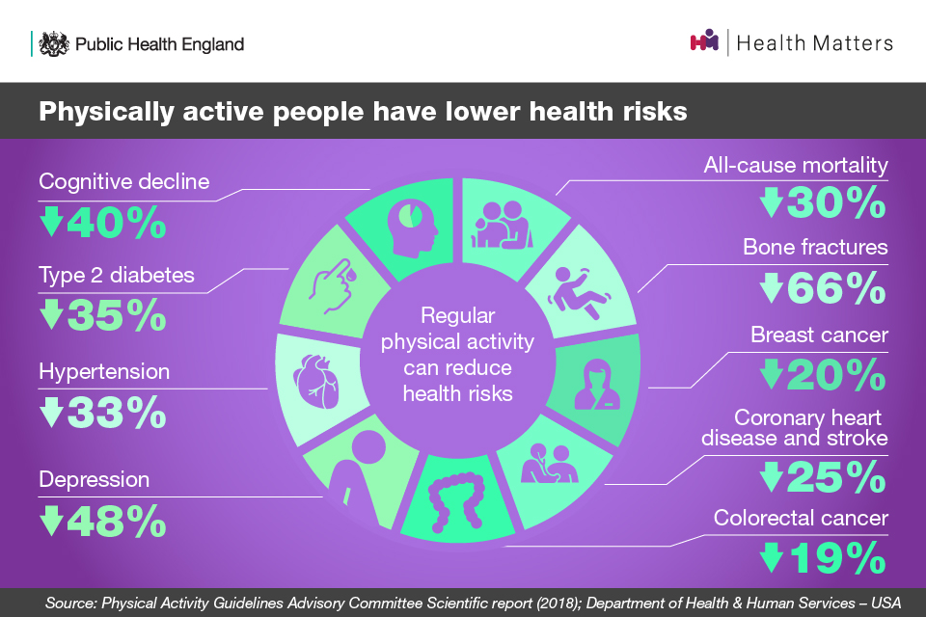
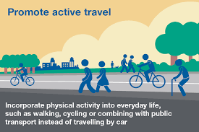
Promote active travel & physical activity

Slide 3
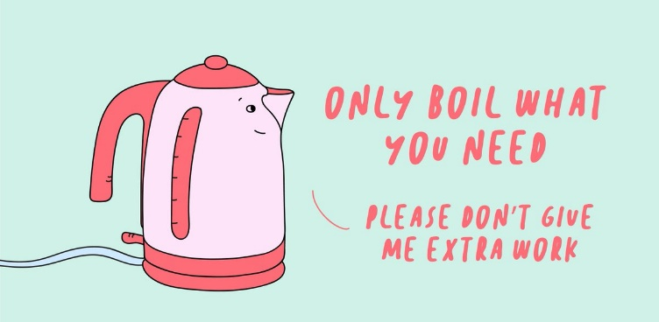
Posters - staff

