Slide 1
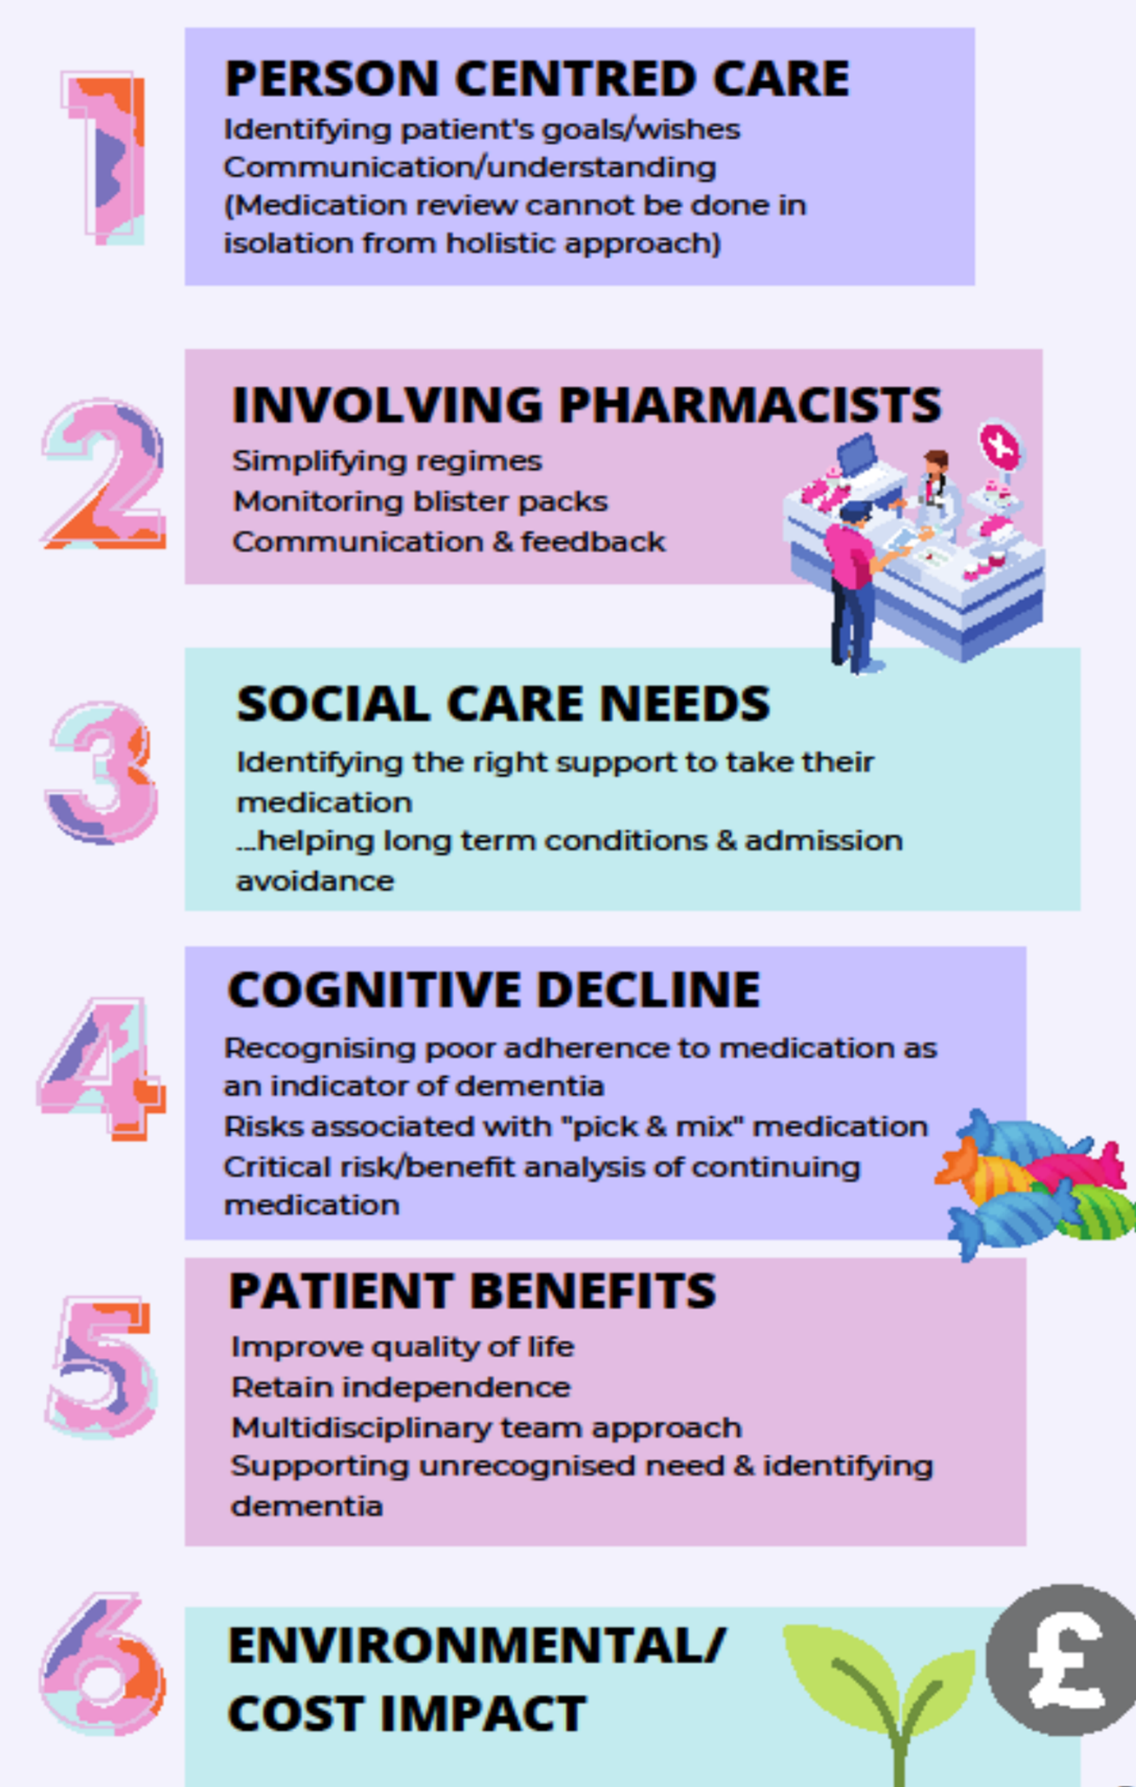
“Show me your meds, please?”
A simple question enhancing patient centred care, reducing risks, costs and environmental impact
Gompertz D, Lead Complex Care GP, South Somerset
deborah.gompertz@ydh.nhs.uk
Clegg I, PCN Clinical Pharmacist, South Somerset ianclegg@nhs.net
Medicines Impact; England:
25% of yearly NHS CO2 emissions
£300 million not taken each year.
A Solution in South Somerset:
The Complex Care GP team noticed that often medicine adherence was only reliably detected by looking at peoples’ medication stocks at home.
Asking:
“Can you show me your meds… please?”
Identified that 1 in 4 people visited were non-adherent.
Challenges:
Reassurance needed that reducing medication is not withdrawing medical care.
Avoiding increased clinical workload… by:
Fund extra pharmacy support through financial savings?
2. Reallocation of resources from low impact routine, high volume medication review to targeted reviews?
Pharmacy Team Roles:
Shared decision making with patient.
Regime simplification to aid compliance and reduce wastage
Suggest cost effective and novel solutions to the varied medication problems that were encountered.
Two way information conduit between local community pharmacies and the wider healthcare team.
Learning points:
Holistic medication reviews provide insight to patient priorities and cognition, and should be considered as one piece of the jigsaw of a holistic patient assessment.
2) One question…. leads to:
Saving NHS resources,
Beneficial environmental impact
Reduce risk of incorrectly taken medication
3) Pivotal trusting relationships within community teams who share the same ethos around person centred care.
4) National/international adoption could have an enormous impact on wellbeing for patients and the environment.

